Slide 1
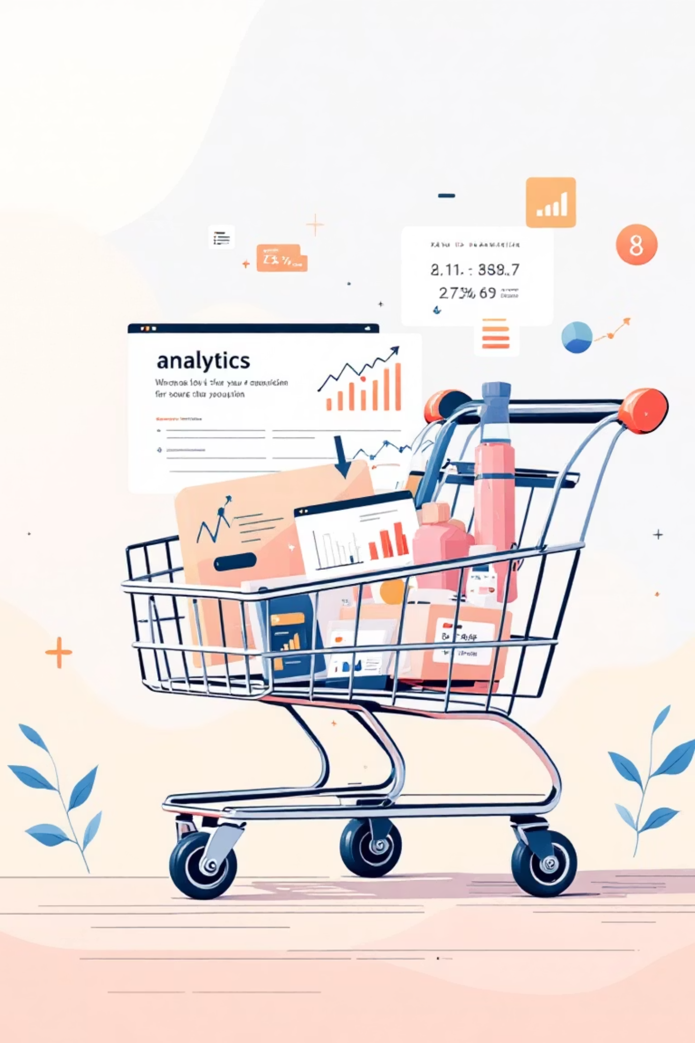
Customer Shopping Behavior Analysis
This project delves into customer shopping behavior, leveraging transactional data to uncover key insights. Our goal is to understand spending patterns, identify customer segments, recognize product preferences, and analyze subscription behavior to drive strategic business decisions.

Slide 2

Project Overview
Unveiling Insights from Transactional Data
1
2
3
Spending Patterns
Customer Segmentation
Product Preferences
Analyze how customers allocate their budgets across various product categories.
Identify distinct groups of customers based on their purchasing habits and demographics.
Determine which products resonate most with different customer segments.
4
5
Subscription Behavior
Strategic Decisions
Examine factors influencing subscription decisions and their impact on revenue.
Translate data-driven insights into actionable business strategies.

Slide 3


Chapter 1
Dataset Summary: A Foundation for Discovery
Our analysis is built upon a robust dataset comprising 3,900 customer purchases, with 18 distinct columns providing a comprehensive view of shopping behavior.
Rows: 3,900 unique transactions
Columns: 18 detailed features
Key Features
Customer Demographics: Age, Gender, Location, Subscription Status
Purchase Details: Item, Category, Amount, Season, Size, Color
Shopping Behavior: Discount, Promo, Previous Purchases, Frequency, Review, Shipping
Crucially, only 37 values were missing in the "Review Rating" column, ensuring a high level of data integrity for our analysis.

Slide 4
Chapter 2
Exploratory Data Analysis: Python's Role in Data Preparation
Our journey began with meticulous data preparation and cleaning using Python, laying the groundwork for robust analysis.
01
02
03
Data Loading & Initial Exploration
Missing Data Handling
Column Standardization
Identified and imputed null values in the Review Rating column using the median rating specific to each product category.
Renamed all columns to snake_case for improved readability and consistent documentation.
Imported dataset with pandas and utilized df.info() and .describe() for initial structural and statistical overview.
04
05
Feature Engineering
Data Consistency Check & Integration
Created an age_group column by binning customer ages and calculated purchase_frequency_days.
Verified and dropped the redundant promo_code_used column. Subsequently, the cleaned data was loaded into PostgreSQL for SQL-based analysis.

Slide 5
Chapter 3
Data Analysis with SQL: Unlocking Business Transactions
Structured SQL queries in PostgreSQL provided targeted answers to critical business questions, revealing key transactional insights.
REVENUE
CUSTOMERS
Revenue by Gender
High-Spending Discount Users
Female customers generated $75,191, while male customers contributed significantly more with $157,890 in total revenue.
839 customers used discounts yet maintained an above-average purchase amount, indicating effective discount targeting for some segments.
PERFORMANCE
PRODUCTS
Shipping Type Comparison
Top 5 Products by Rating
Express shipping correlates with a higher average purchase amount of $60.48, compared to Standard shipping at $58.46.
Gloves lead with an average rating of 3.86, followed by Sandals (3.84), Boots (3.82), Hat (3.80), and Skirt (3.78).
SUBSCRIPTION
DISCOUNTS
Subscribers vs. Non-Subscribers
Discount-Dependent Products
Non-subscribers contribute higher total revenue ($170,436) despite a similar average spend per customer compared to subscribers ($62,645).
Hats and Sneakers have the highest discount rates (50% and 49.66% respectively), suggesting strong price sensitivity for these items.

Slide 6
Top Products & Customer Segmentation
SEGMENTATION
CATEGORY
Customer Segments
Top 3 Products Per Category
The customer base is primarily Loyal (3,116 customers), with a smaller New (83) and Returning (701) segment.
Rank
Category
Item Purchased
Orders
PURCHASE BEHAVIOR
Repeat Buyers & Subscriptions
A significant portion of repeat buyers (with >5 purchases) are non-subscribers (2,518), indicating an opportunity to convert them to subscribers.
1
Accessories
Jewelry
171
1
Clothing
Blouse
171
1
Footwear
Sandals
160
AGE & REVENUE
Revenue by Age Group
1
Outerwear
Jacket
163
Young Adults generate the highest revenue ($62,143), followed closely by Middle-aged ($59,197) and Adult groups ($55,978).
Jewelry, Blouses, Sandals, and Jackets consistently rank as the top purchased items within their respective categories.

Slide 7
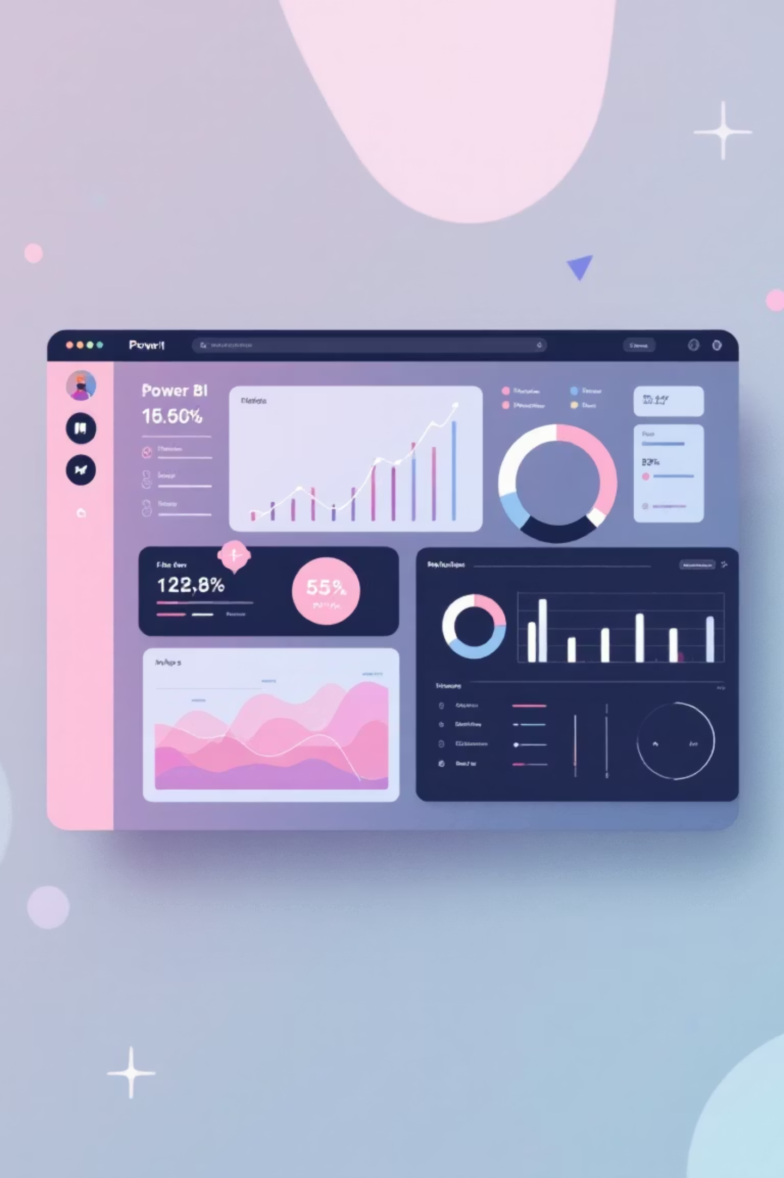
Chapter 4
Visualizing Insights: The Power BI Dashboard
An interactive Power BI dashboard brings our data to life, providing a dynamic and accessible way to explore customer behavior.
Key Metrics at a Glance:
3.9K Number of Customers
$59.76 Average Purchase Amount
3.75 Average Review Rating

Slide 8
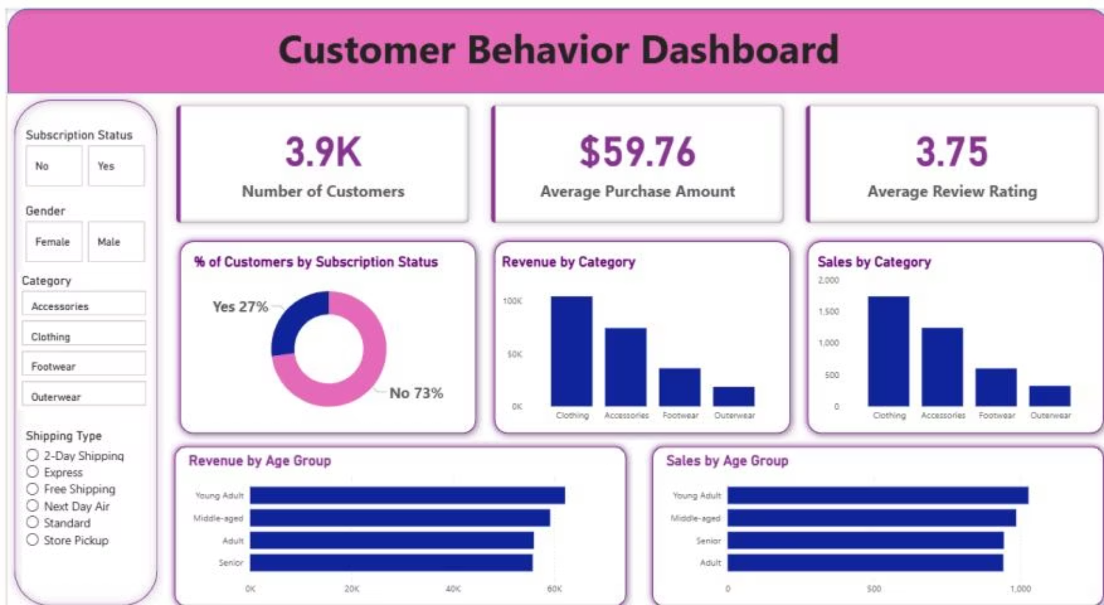
Dashboard Highlights: Filters & Visualizations
Interactive Filters for Deep Dives
Subscription Status: (No, Yes)
Gender: (Female, Male)
Category: (Accessories, Clothing, Footwear, Outerwear)
Shipping Type: (2-Day Shipping, Express, Free Shipping, Next Day Air, Standard, Store Pickup)
Key Visualizations
% of Customers by Subscription Status: 27% Yes, 73% No
Revenue by Category: Clothing, Accessories, Footwear, Outerwear dominate.
Sales by Category: Mirrors revenue trends, confirming category importance.
Revenue by Age Group: Young Adults, Middle-aged, Adults, Seniors provide clear insights.
Sales by Age Group: Consistent with revenue, guiding targeted marketing.

Slide 9





Chapter 5
Business Recommendations: Actionable Strategies for Growth
Our analysis culminates in targeted recommendations designed to enhance customer engagement, optimize sales, and foster loyalty.
Boost Subscriptions
Customer Loyalty Programs
Review Discount Policy
Implement enhanced promotional campaigns and exclusive benefits to drive subscription conversions, especially among repeat buyers.
Develop and promote tiered loyalty programs to reward repeat buyers and encourage progression to the "Loyal" segment.
Evaluate the impact of discounts on overall margins. Strategically adjust discount offerings to balance sales boosts with profitability.

Slide 10
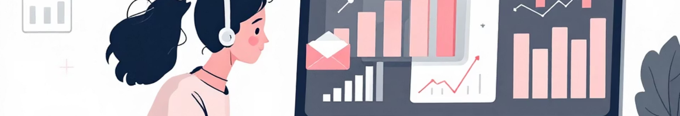



Refining Product & Marketing Strategies
Further recommendations focus on optimizing product visibility and ensuring marketing efforts reach the most valuable customer segments.
Product Positioning
Targeted Marketing
Continuous Monitoring
Feature top-rated and best-selling products prominently in marketing campaigns and on the website to leverage social proof and demand.
Direct marketing spend towards high-revenue age groups (Young Adult, Middle-aged) and customers who prefer Express shipping, as they demonstrate higher purchasing power.
Regularly monitor key metrics and update the Power BI dashboard to track the effectiveness of implemented strategies and adapt as needed.

